Slide 1

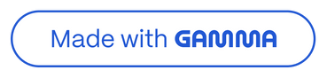
Spotify Music Trends: Streaming Data at Scale
Analyzing Global Listener Behavior and Genre Evolution Using Azure
by ABHISHEK NIRAJ
AN
Notes:
1

Slide 2

Project Overview
Objective:
Ingest streaming music data from Spotify APIs using Azure cloud.
Analyze global listener behavior and genre evolution.
Data Ingestion
Cloud Processing
Spotify API streaming data collection
Azure cloud services for scalability
Analytics & Visualization
Scope
Trend analysis on listening patterns
Spotify API data ingestion
Data transformation with PySpark
Data lake architecture deployment
Notes:
2

Slide 3

Roles & Responsibilities
Data Pipeline Development
Data Architecture & Security
Azure Data Factory API integration
Azure Data Lake (Raw → Clean → Curated).
Azure Data Factory for playlist and track data.
Unity Catalog data governance
PySpark transformations in Databricks
Role-based access via Entra ID
Transformation
Analytics & Visualization
PySpark jobs in Databricks for data processing.
Trend analysis on listening patterns
Notes:
3

Slide 4
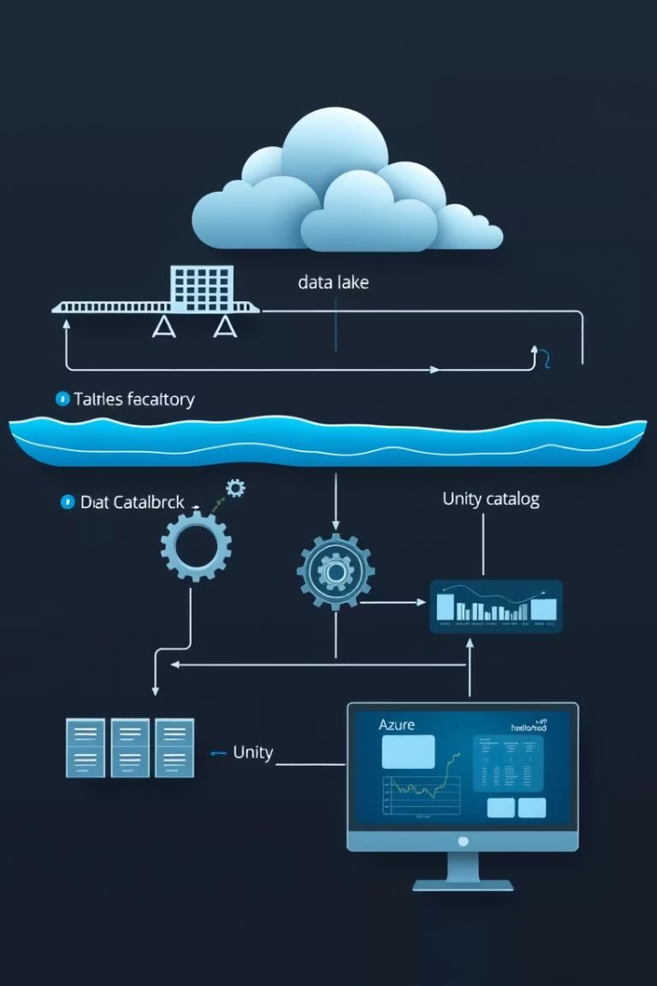




Architecture Diagram
Data Factory
Spotify APIs
Data Lake
Raw/Clean/Curated
Databricks
PySpark Jobs
Unity Catalog
Organized Data
Notes:
4

Slide 5
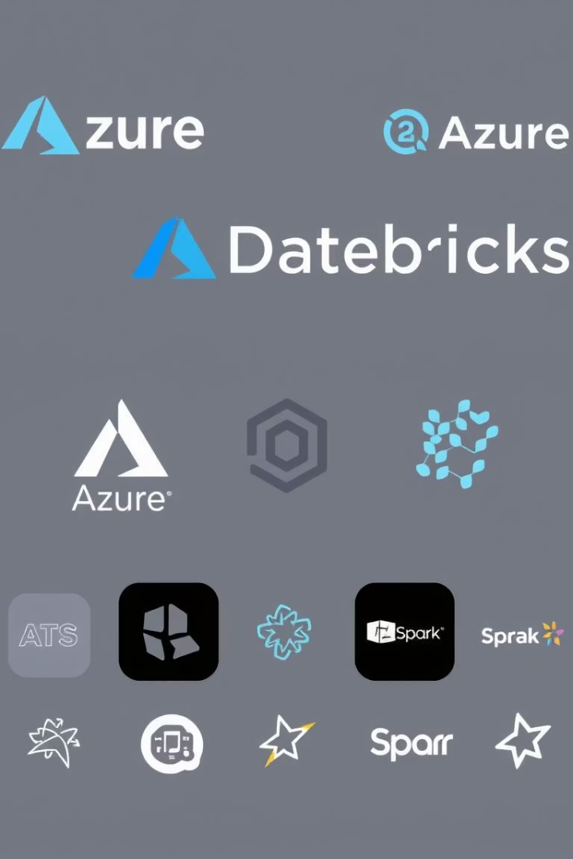



Technologies Used
Azure Data Factory
Azure Data Lake Storage
Azure Databricks
Pyspark(RDDs, DataFrames, Datasets)
Unity Catalog
Entra ID
Notes:
5

Slide 6
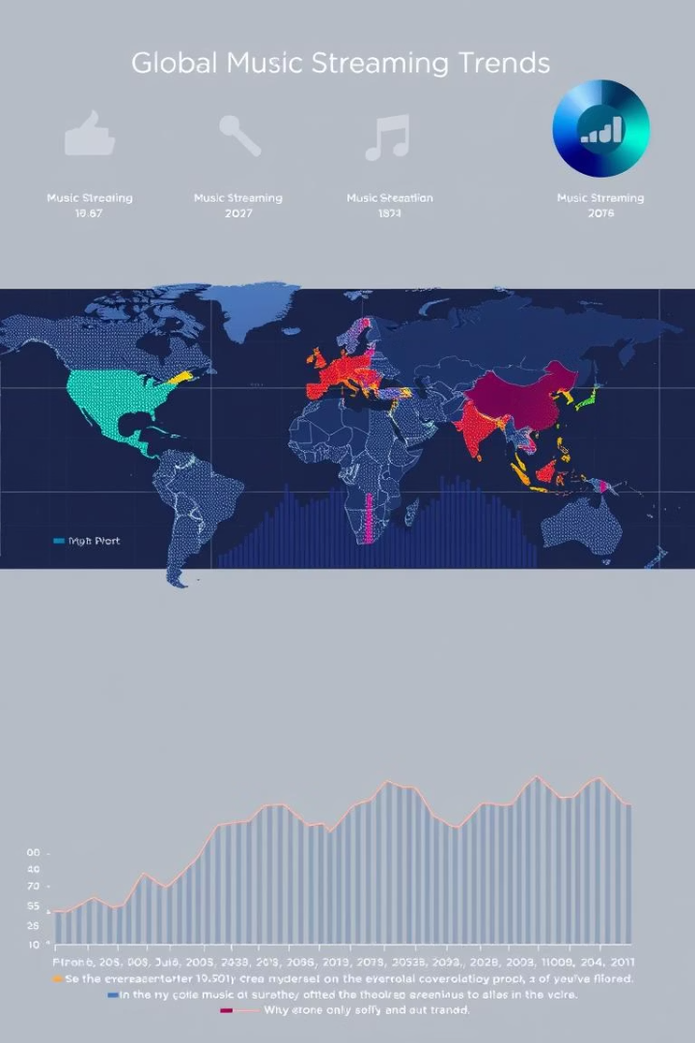



Key Insights & Results
1
Trends
2
Behavior
3
Genres
Genre popularity, listener behavior trends, and evolving music patterns.
Notes:
6

Slide 7
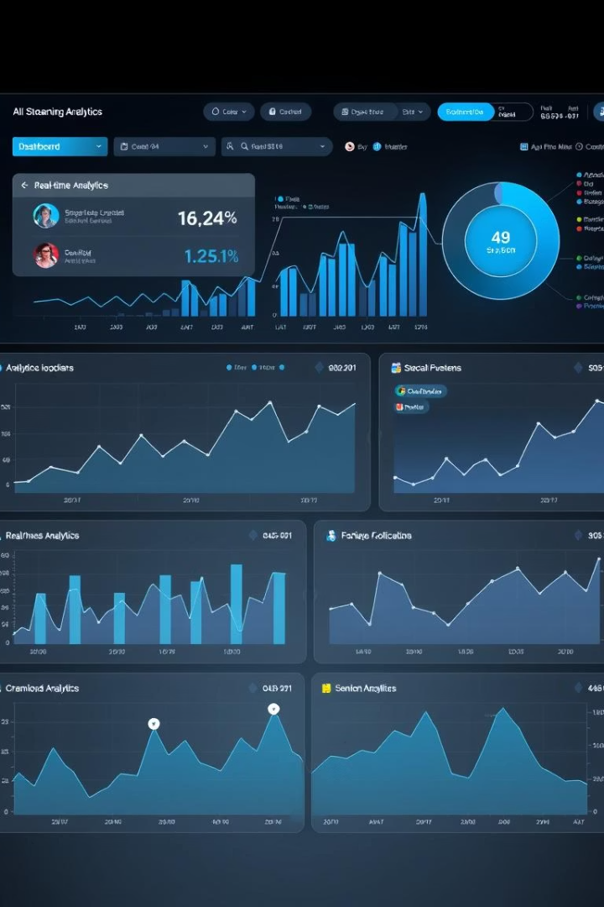
Future Work
Real-time
1
Integrate with Azure Stream Analytics.
2
Dashboards
Dynamic dashboards in Power BI or Tableau.
Sentiment
3
Incorporate user sentiment analysis.
4
Expand
Podcast and audiobook trends.
Predict
5
ML models to predict music trends.
Notes:
7

Slide 8

Conclusion
Secure, scalable data pipeline for Spotify data.
Leveraged analytical power of cloud tools with PySpark.
Notes:
8

Slide 9

Thank You
We appreciate your time and attention!
Notes:
9

